Slide 1
Data Access with ADO.NET
Database Application Development
Lecturer: Garry singh
Manukau Institute of Technology

Slide 2
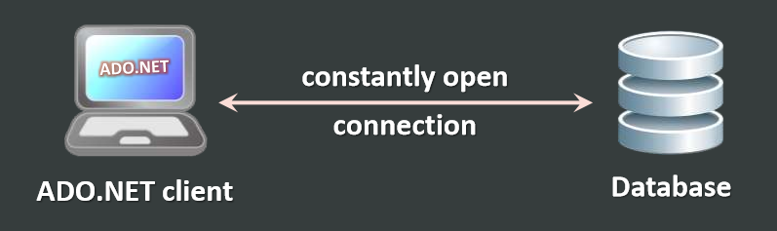
Data Access Models
Connected Model
Connected data access model
Applicable to an environment where the database is constantly available
Too much effort to issue SQL commands by hand

Slide 3
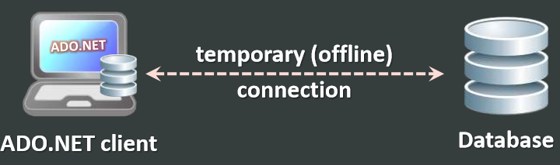
Disconnected Model
Disconnected data access model
A subset of the central database is copied locally at the client and he works with the copy
Database synchronization is done offline

Slide 4
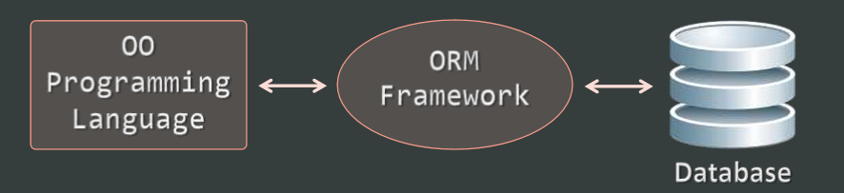
ORM Model
ORM data access model
Maps database tables to classes and objects
Objects can be automatically persisted in the database
Can operate in both connected and disconnected modes

Slide 5
ORM Model: Benefits and Problems
ORM model benefits
Increased productivity – writing less code
Use objects with associations instead of tables and SQL commands
Integrated object query mechanism
ORM model drawbacks:
Less flexibility – SQL is automatically generated
Performance issues (sometimes)

Slide 6
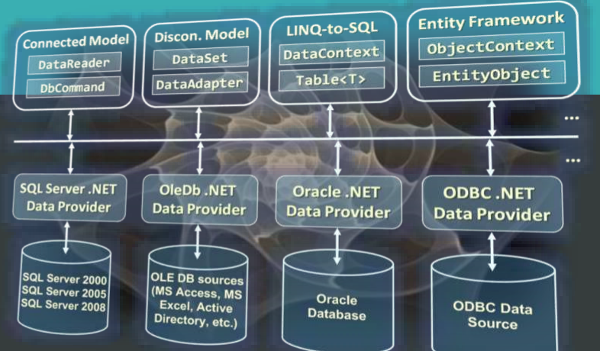
ADO.NET Architecture

Slide 7
What is ADO.NET?
ADO.NET is a standard .NET class library for accessing databases, processing data and XML
An API for working with data in .NET
Supports connected, disconnected and ORM data access models
Excellent integration with LINQ, XML and WCF
Allows executing SQL in RDBMS systems
DB connections, data readers, DB commands
Supports the ORM approach
LINQ-to-SQL and ADO.NET Entity Framework

Slide 8
Namespaces in ADO.NET
System.Data
ADO.NET core classes
System.Data.Common
Common classes for all ADO.NET technologies
System.Data.Linq
LINQ to SQL framework classes
System.Data.Entity
Entity Framework classes
System.Xml
XML processing classes

Slide 9
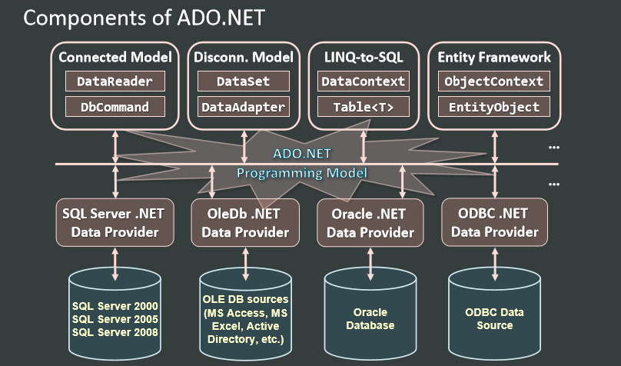

Slide 10
ADO.NET Data Providers
Data Providers are collections of classes that provide access to various databases
For different RDBMS systems different Data Providers are available
Each provider uses vendor-specific protocols to talk to the database server
Data providers define several common objects:
Connection – to connect to the database
Command – to execute an SQL command
DataReader – to retrieve data
Entity Framework support (optionally)

Slide 11
Data Providers in ADO.NET
Several standard ADO.NET Data Providers come as part of .NET Framework
SqlClient – accessing SQL Server
OleDB – accessing standard OLE DB data sources
Odbc – accessing standard ODBC data sources
Oracle – accessing Oracle database
Third party Data Providers are available for:
MySQL, PostgreSQL, Interbase, DB2, SQLite
Other RDBMS systems and data sources

Slide 12
Third Party Data Providers
ADO.NET Driver for MySQL (Connector/NET)
http://www.mysql.com/products/connector/
Supports Entity Framework (from version 6.0)
Oracle Data Provider for .NET (ODP.NET)
http://www.oracle.com/technetwork/topics/dotnet
Does not support Entity Framework
.NET Data Provider for PostgreSQL
http://npgsql.projects.postgresql.org/
Supports Entity Framework

Slide 13
Standard Data Provider Classes
System.Data.SqlClient and System.Data.SqlTypes
Data Provider classes for accessing SQL Server
System.Data.OleDb
Classes for accessing OLE DB data sources
System.Data.Odbc
Classes for accessing ODBC data sources
System.Data.Oracle
Classes for accessing Oracle databases

Slide 14
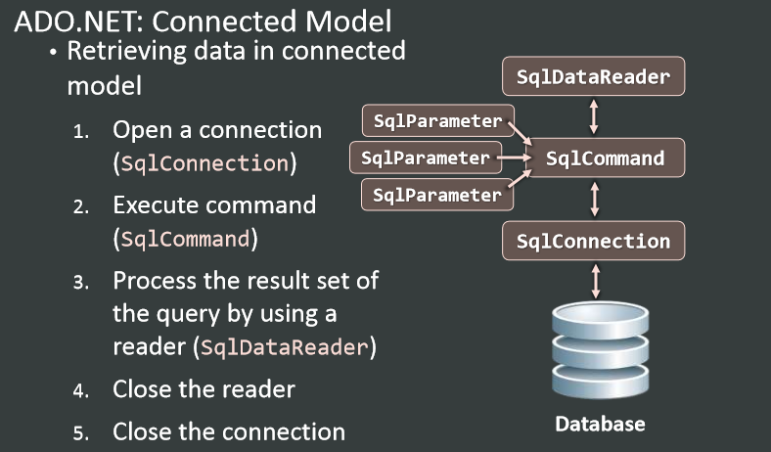

Slide 15
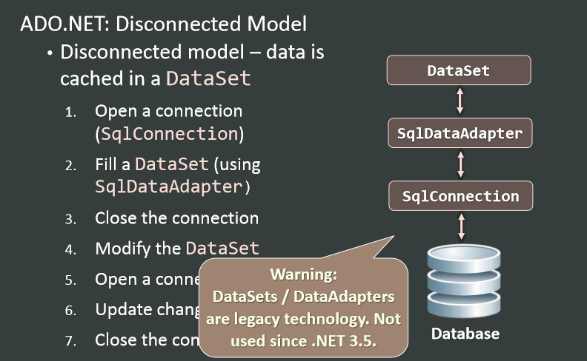

Slide 16
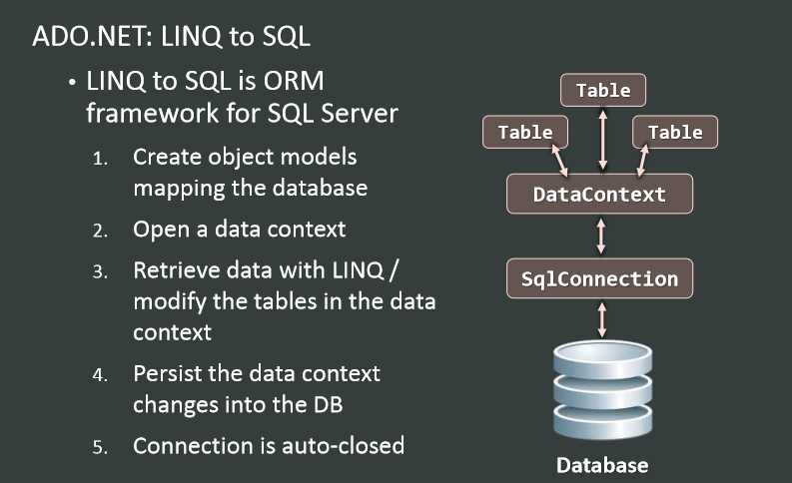

Slide 17
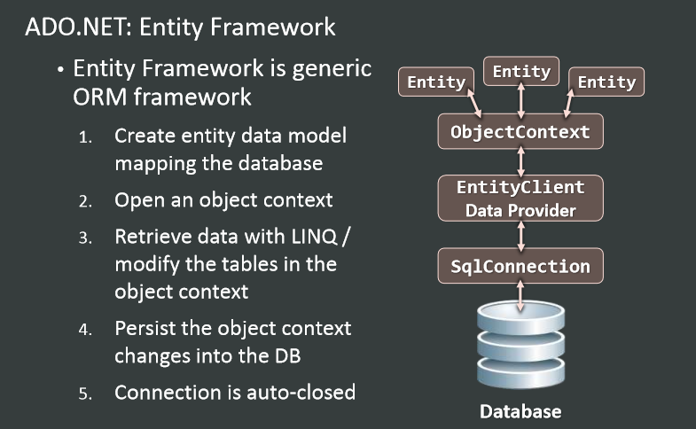

Slide 18
SQL Client Data Provider
SqlClient Data Provider
SqlConnection
Establish database connection to SQL Server
SqlCommand
Executes SQL commands on the SQL Server through an established connection
Could accept parameters (SQLParameter)
SqlDataReader
Retrieves data (record set) from SQL Server as a result of SQL query execution

Slide 19
LIVE DEMO

